Slide 1
Instruction for 2D/3D Simulation
Linux based instruction
Set up gitlab on local computer and on fractal and clone the repository “git@gitlab.uni-ulm.de:krill-group/phasefield-simulation_cpp.git”
Install VS code on fractal account
ssh -X username@134.60.35.129 code for remote VS code on fractal
(set up some “aliases” in Linux for shortcuts)
Julian Jakob 09-12-2022
Edited
09-02-2023

Slide 2
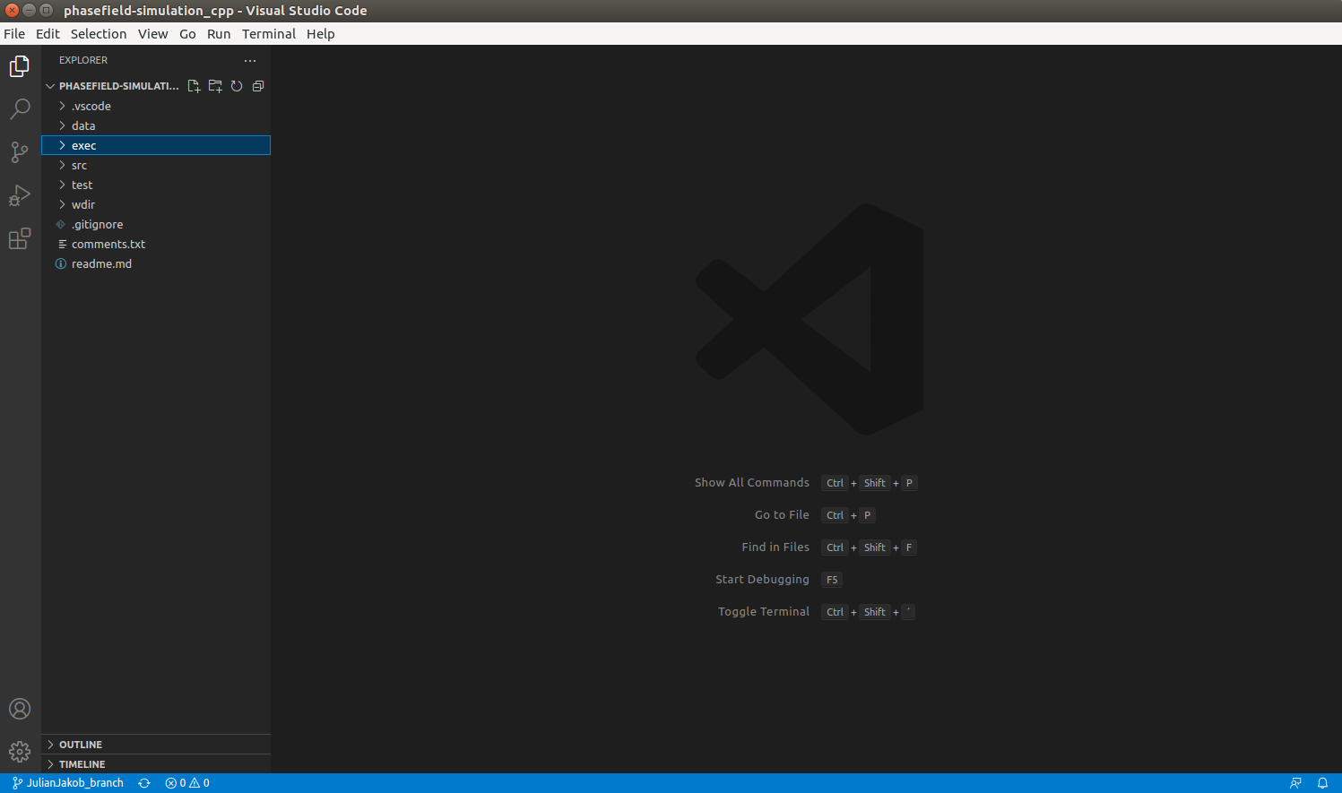
You should see this, if you open the directory “phasefield-simulation.cpp”

Slide 3
Open “data” and “exec”
In “data” you can find .ops files start configuration
In “exec” you should choose the simulation type (2D/3D, isotropic/anisotropic, with/without pinning particles)
sim2d aniso 2D, simiso2d iso 2D

Slide 4
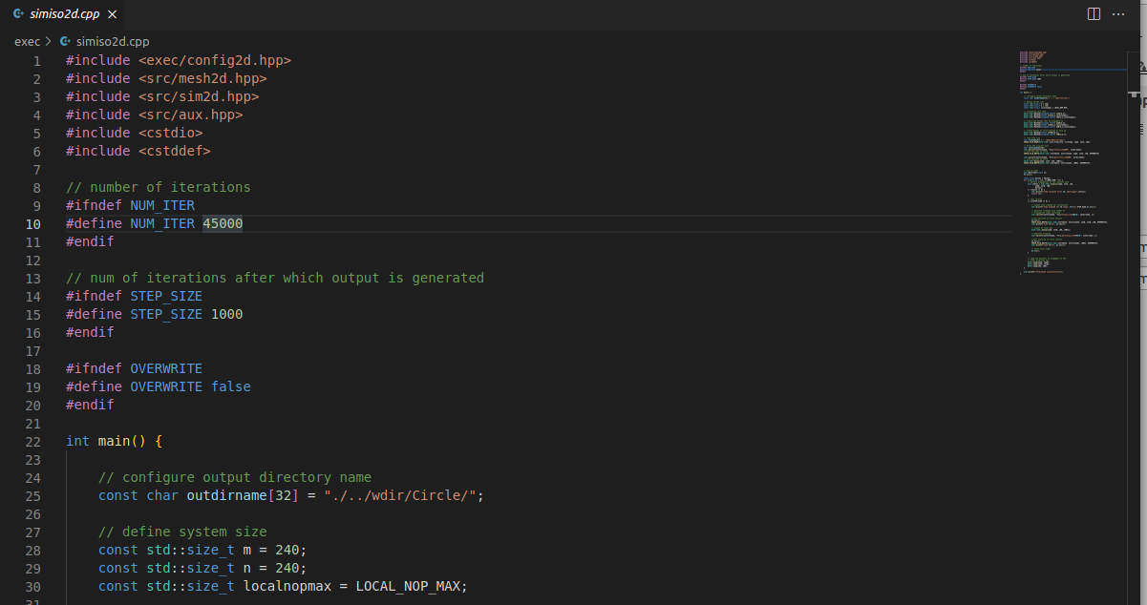
2D simulation isotropic
Write all coefficients like the number of grains (NOF_GRAINS), L, DeltaX, DeltaT… in config2d.hpp
Open simiso2d.cpp, change endstep (last iteration), change step size (after t time steps it writes the results in .txt file)
Output directory has to be in the same directory as /exec (results every t time steps)
Set system size (max values of x and y of simulation cell)

Slide 5
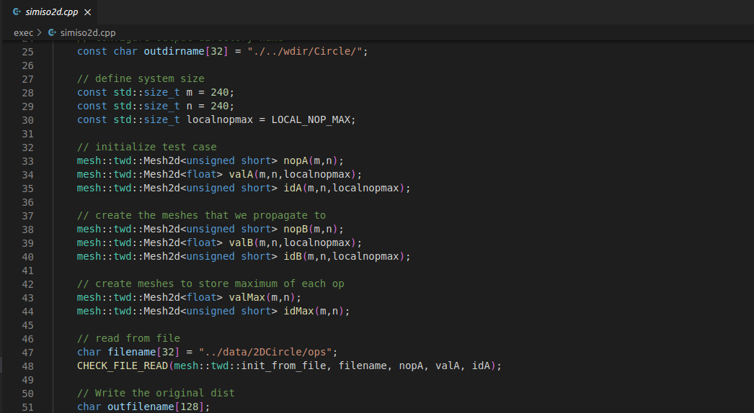
2D simulation isotropic
Change .ops input file for start configuration (always prefix “../data/” to jump from exec/ in the data/ directory)

Slide 6
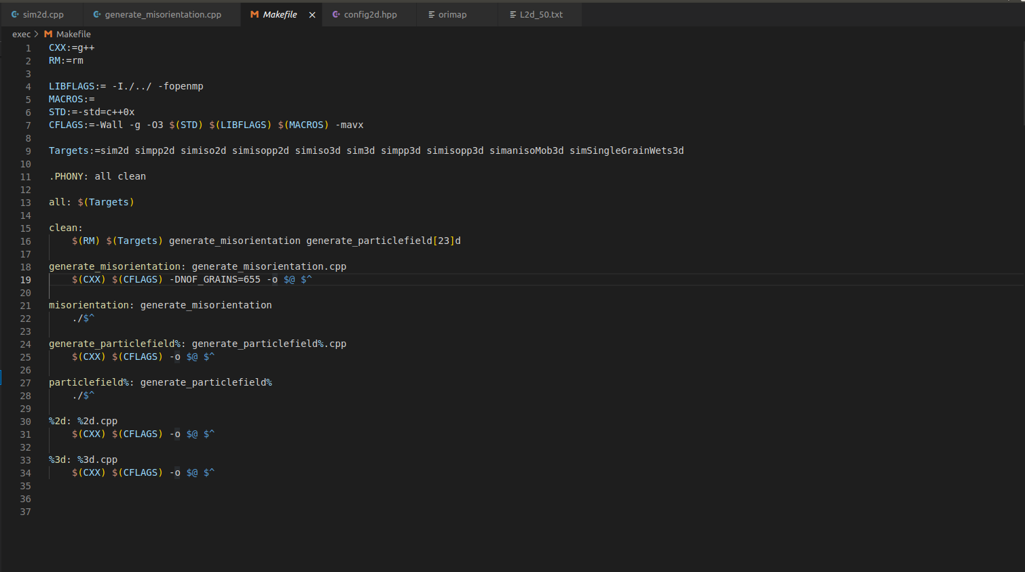
Navigate to /exec/Makefile
Change this value to your MaxID of the .ops file

Slide 7
2D simulation isotropic
Open terminal (strg+t) and navigate to your cloned git repository
For remote terminal of fractal on local: “ssh username@134.60.35.129”
Type “make -B simiso2d” to set your changes for the code
“./simiso2d > run_temp.txt” to start the simulation (every output of the shell is saved in the .txt file)

Slide 8
2D simulation isotropic
Copy the results from fractal to your local computer with typing in local terminal “scp -r username@134.60.35.129:path target”
“path” is the outdir of the code on fractal, “target” the path on your local
Download the Matlab functions provided by Jules (sim2Res.m, PFRes2Mat.m, colormapping.m) and save them in “/home/[username]/Documents/MATLAB/MatlabFunctions”
Open sim2Res in Matlab
Change “resultdir” to your result directory (“target” directory from above), change “dim” to 2 and the x=xmax, y=ymax values of the cell

Slide 9
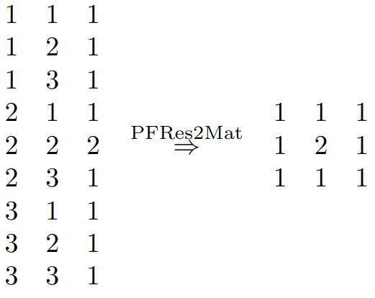
2D simulation isotropic
PFRes2Mat formats the complicated .txt file to a readable 240x240 matrix
Simple example:
ID Matrix can be mapped by function “colormapping.m”
X Y ID
ID Matrix

Slide 10
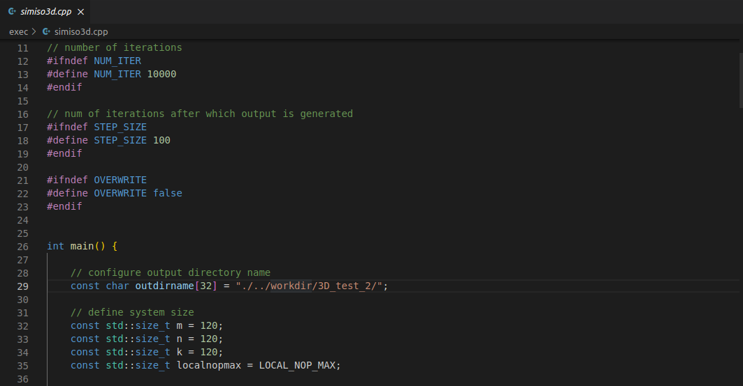
3D simulation isotropic
Write all coefficients like the number of grains (NOF_GRAINS), L, DeltaX, DeltaT… in config3d.hpp
Open simiso3d.cpp, change endstep (last iteration), change step size (after t time steps it writes the results in .txt file)
Output directory has to be in the same directory as /exec (results every t time steps)
Set system size (max values of x, y and z of simulation cell)

Slide 11
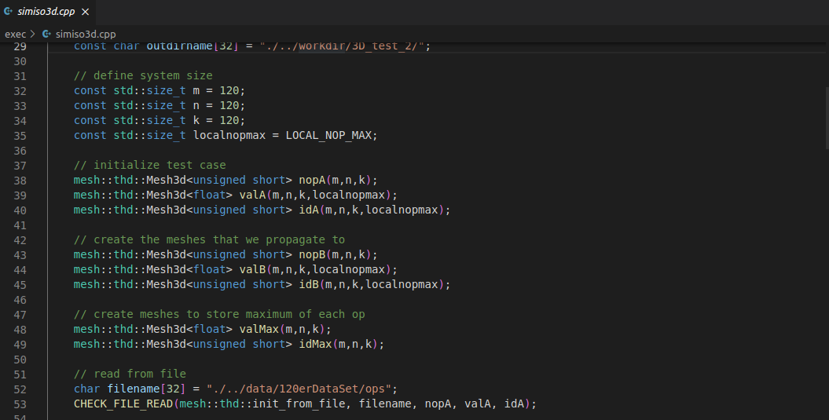
3D simulation isotropic
Change .ops input file for start configuration (always prefix “../data/” to jump from exec/ in the data/ directory)

Slide 12
3D simulation isotropic
Open terminal (strg+t) and navigate to your cloned git repository
For remote terminal of fractal on local: “ssh username@134.60.35.129”
Type “make -B simiso3d” to set your changes for the code
“./simiso3d > run_temp.txt” to start the simulation (every output of the shell is saved in the .txt file)

Slide 13
3D simulation isotropic
Copy the results from fractal to your local computer with typing in local terminal “scp -r username@134.60.35.129:path target”
“path” is the outdir of the code on fractal, “target” the path on your local
Download the Matlab functions provided by Jules (sim2Res.m, PFRes2Mat.m, colormapping.m) and save them in “/home/[username]/Documents/MATLAB/MatlabFunctions”
Open sim2Res in Matlab
Change “resultdir” to your result directory (“target” directory from above), change “dim” to 3 and the x=xmax, y=ymax, z=zmax values of the cell

Slide 14
3D simulation isotropic
“sim2Res” calls “colormapping”, which shows the map of the ID Matrix
It also saves the created images of chosen step t in a new directory “ImageSlices_[step t]” located in the same directory as simulation results

Slide 15
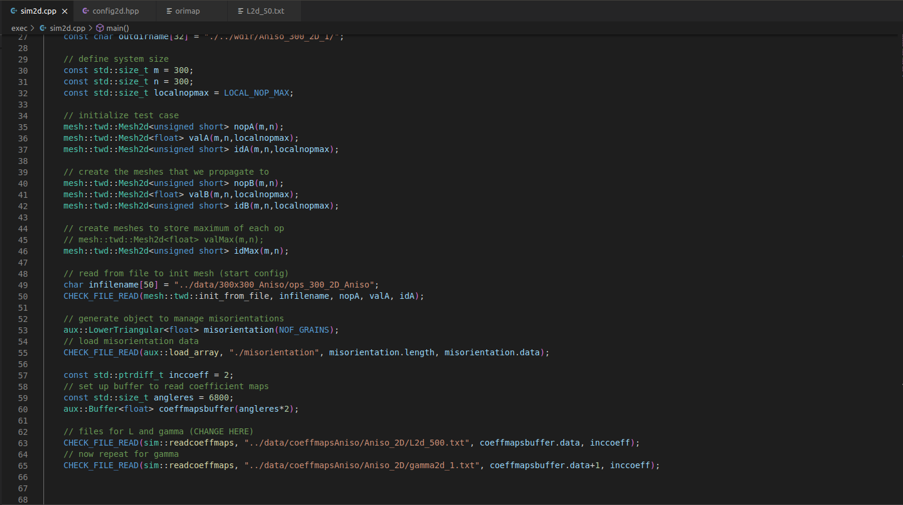
Anisotropic Simulation
Analogous to isotropic except a few settings
Directories of mobility table L and energy table gamma which should be saved in /data/coeffmapsAniso

Slide 16
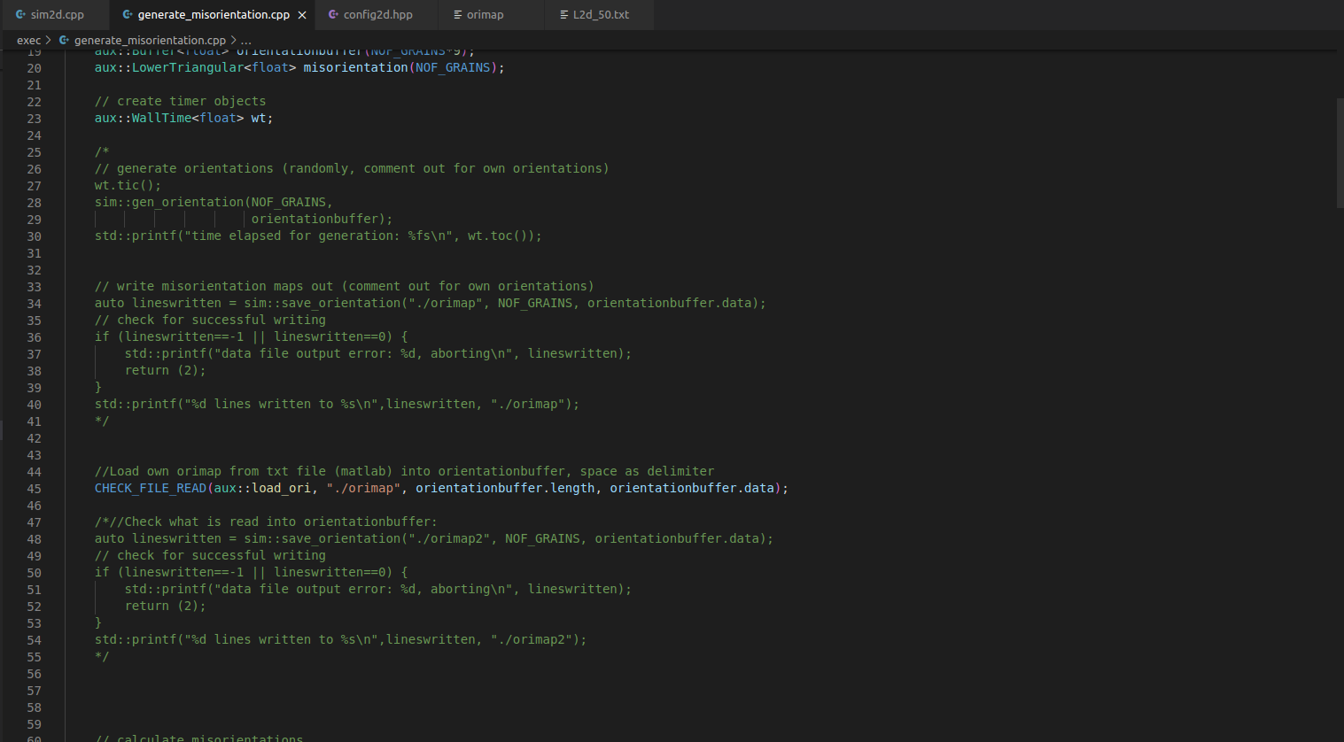
If you use your own orimap, then save it in /exec dir
If not, then delete the saved orimap in /exec
Navigate to /exec/generate_misorientation.cpp
Delete “/*” and “*/”, then it will creat its own orimap (randomly)
For own orientation it should look like the screenshot

Slide 17
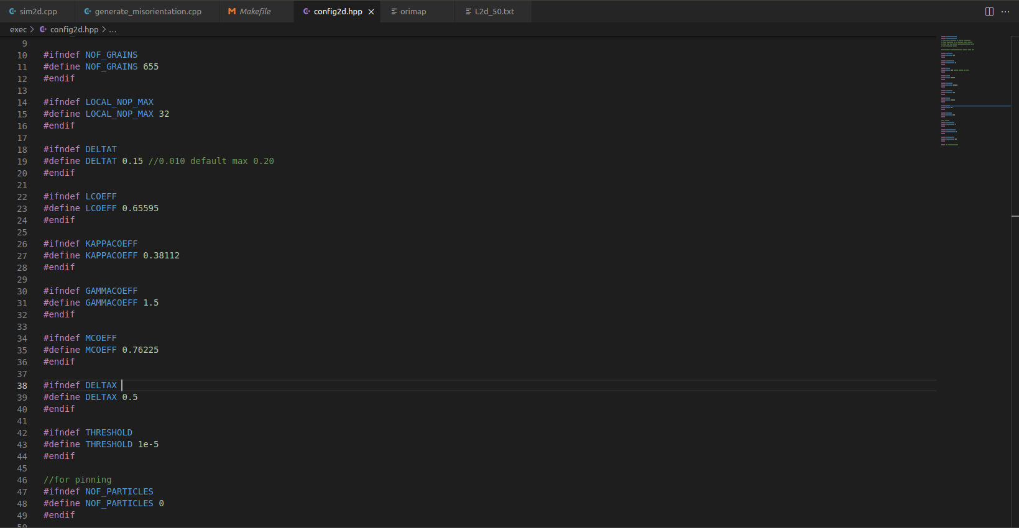
Open /exec/config2d.hpp (or/config3d.hpp)
Change to the output from moelans.m matlab function
For LCOEFF and GAMMACOEFF the max value in the Lcoeff and gammacoeff file

Slide 18
Open terminal (strg+t) and navigate to your cloned git repository in /exec dir
Type in the terminal “make -B misorientation” to create orimap (if own orimap then it is reading in the map) an write all misorientations between the grains in a binary file (in the directory /exec)
“make -B sim2d” (or “make -B sim3d”) to translate all changes of the code
“./sim2d” (or “./sim3d”) to start the simulation

